Slide 1

Twitter Semantic Analysis GROUP -5
Mentor Name : Hareesh
Trainer Name : Neha Gupta
Group Members :
Mr. Aditya Jagtap
Miss. Poorva Khot
Miss. Reshma Jogal
Mr. Kiran Tandale
Mr. Navnath Karanjule
Mr. Abhishek Kodre

Slide 2
Problem Statement:
In this project, the goal is to develop a text classification model that accurately predicts the class of tweets from a dataset with four categories: figurative, irony, sarcasm, and regular. Leveraging natural language processing techniques, the model should be able to differentiate between figurative language, ironic statements, sarcastic remarks, and non-specialized tweets. The project aims to improve our understanding of humor and figurative language in social media content, ultimately enabling more effective sentiment analysis and content recommendation systems.

Slide 3
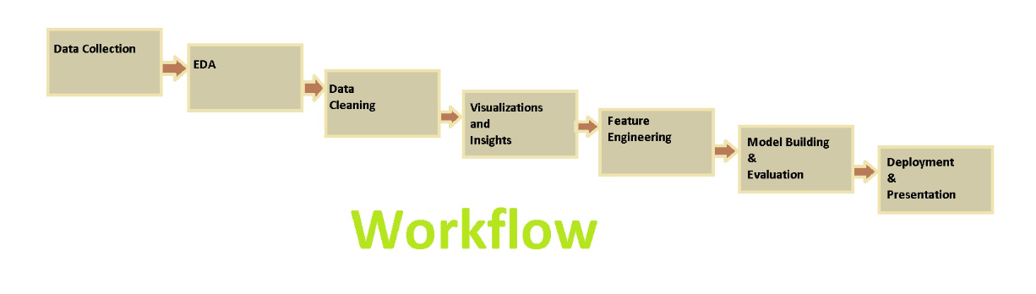
Project Work Flow :
Objective :
The main objective of this project is to develop a robust and accurate system using Natural Language Processing (NLP) techniques to analyse the tweets.

Slide 4
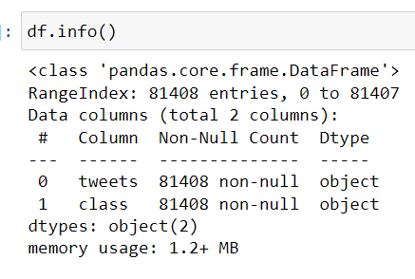
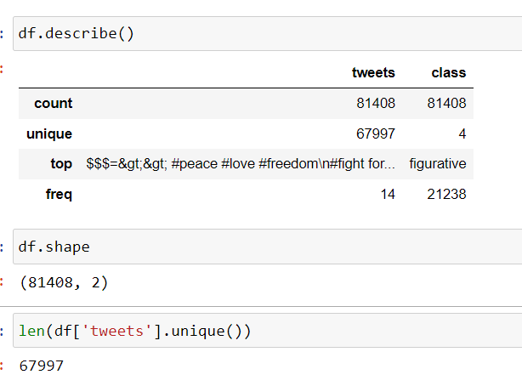
Exploratory Data Analysis:
We will browse through the data and collect some valuable insights with the help of Tables and Visual Plots

Slide 5
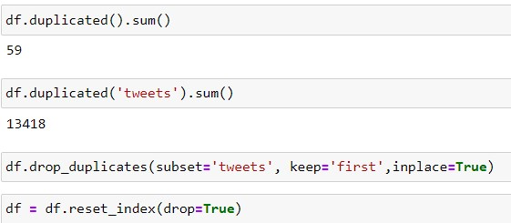
Checking for duplicates and Treating them:
Observations:
We checked for the duplicates in our data and we even checked it for our column ‘tweets’, we found out from there we have a lot of duplicated values.
So we dropped the duplicated value and kept the original ones.

Slide 6
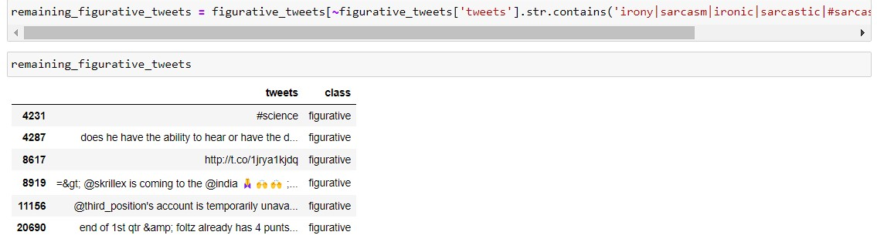
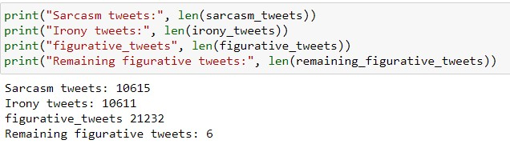
Objective :
We observed that in the figurative class there was a lot of misclassification due to the class containing #sarcasm or #irony.
We checked are there statement where both words like irony and sarcasm coming in the same statement but there were only 6 statement like those.
So according to that we distributed the figurative class into irony and sarcasm.
Hence now we are left with only 3 classes i.e. Regular, irony and sarcasm.

Slide 7
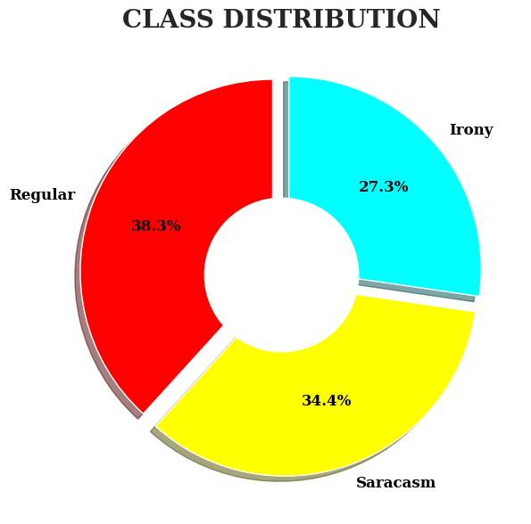
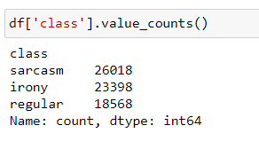
Data visualizations:
For Class Distribution
Observations:
Tweets dataset has three classes in which ‘Irony’,’Sarcasm’,’Regular’
It show the how much percentage tweets include in which class.

Slide 8
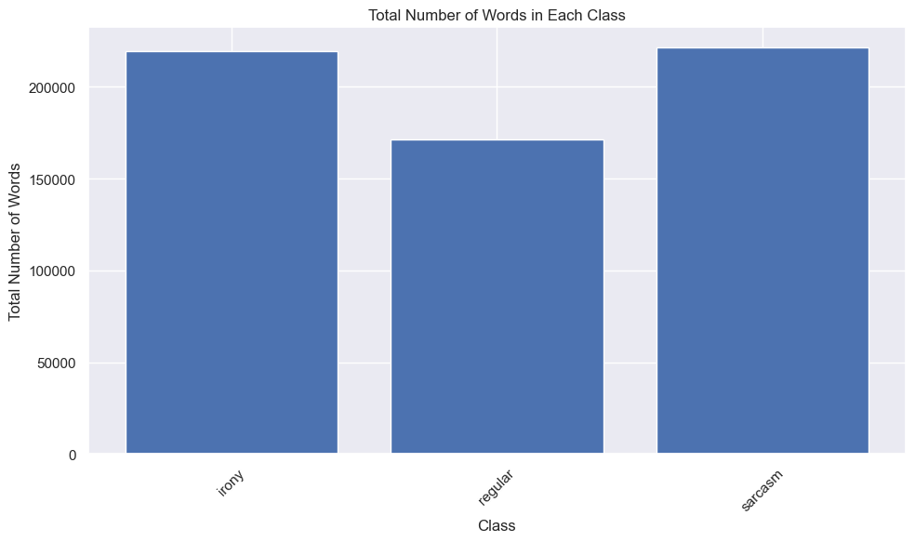
Title column:
Observations:
Total number of words in each class

Slide 9
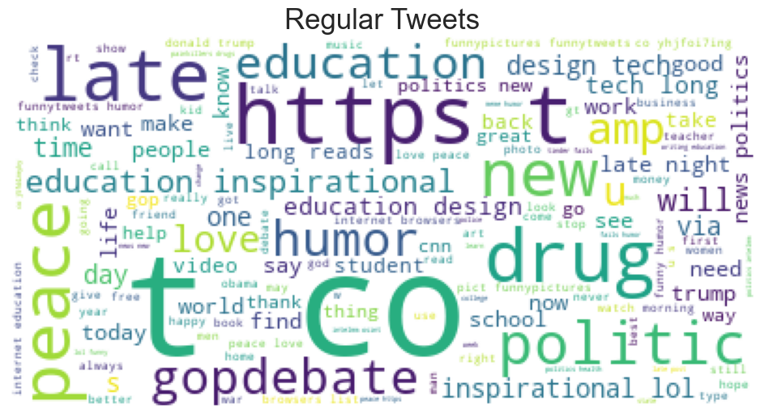
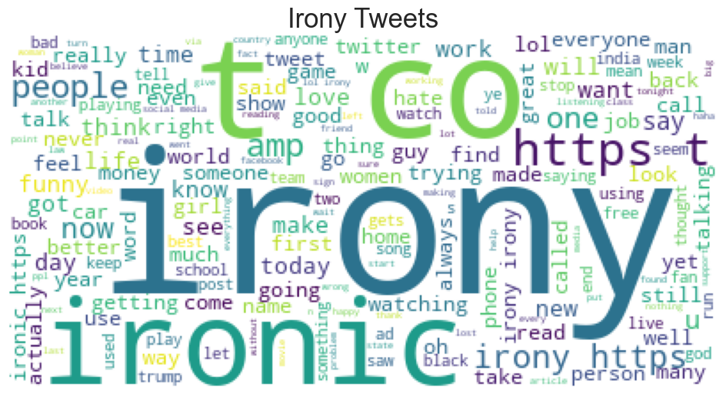
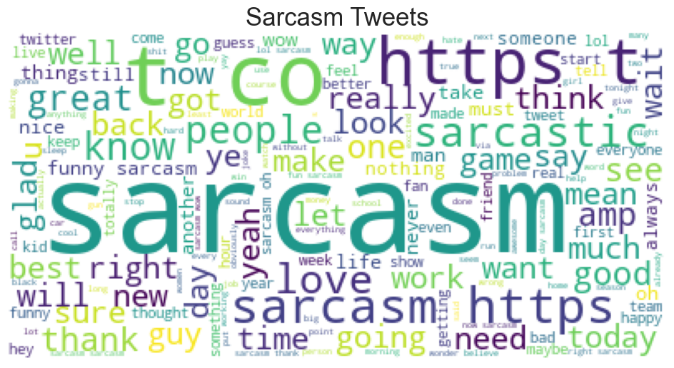
Wordcloud :Regular, Irony & Sarcasm
Observations:
In this wordcloud we can see that there are a lot of links and others stopwords which will probably not help in learning of our model so we need to treat them.

Slide 10
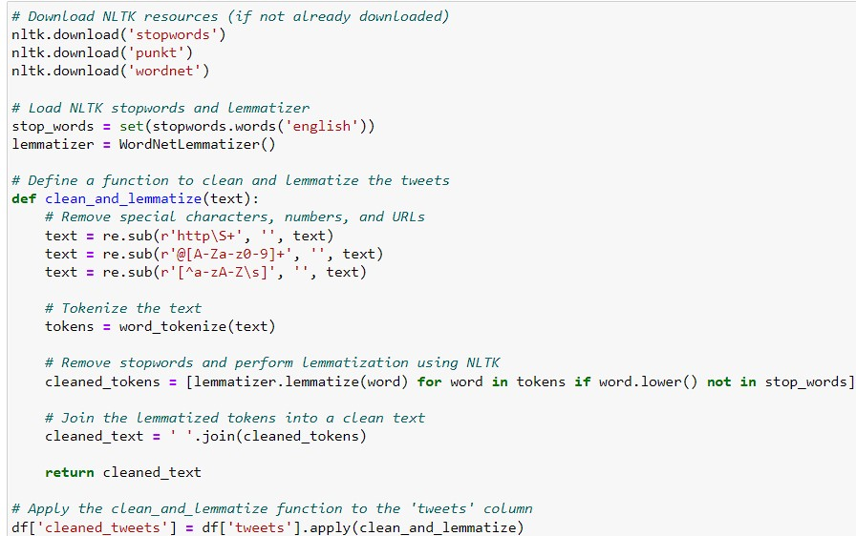
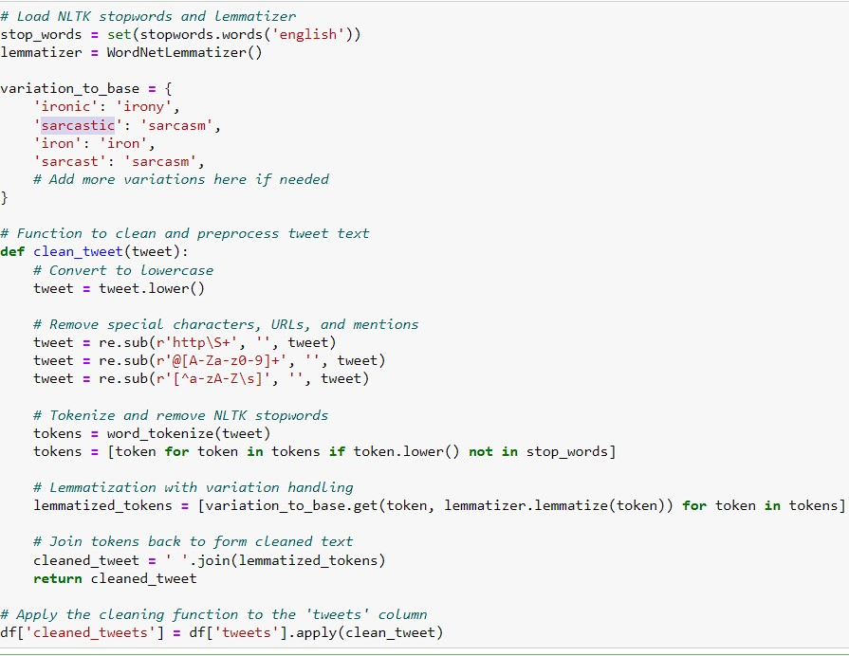
Data-Preprocessing :
We have done the cleaning of the data in two step in first step we have removed all the stopwords, http links, emojis and made in word in lowercase and then lemmatized our data, which gave use the desired result but words like ‘sarcasm and sarcastic’ and ‘irony and ironic’ are same but in lemmatization it is not considered so we did custom lemmatization and we got a proper result for our wordcloud.
Text Cleaning :

Slide 11
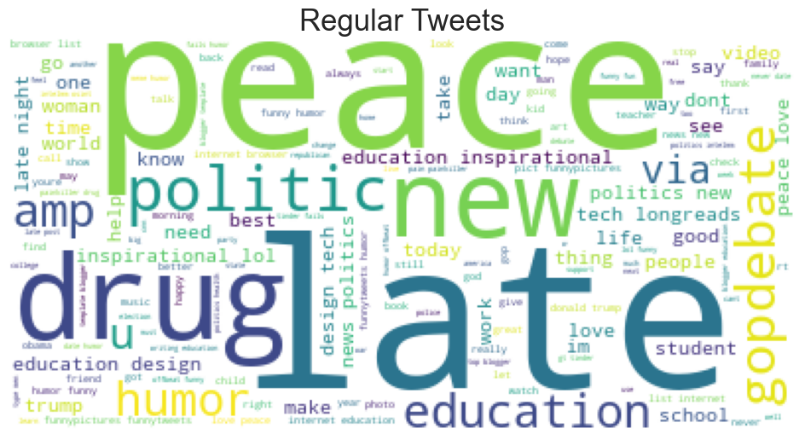
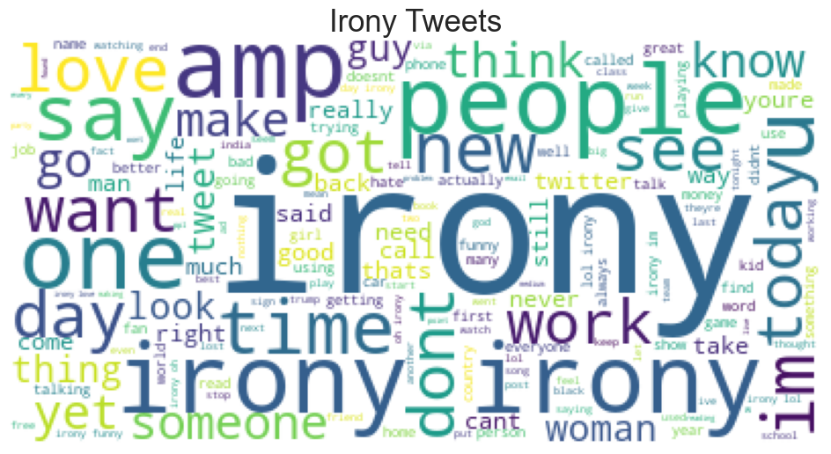
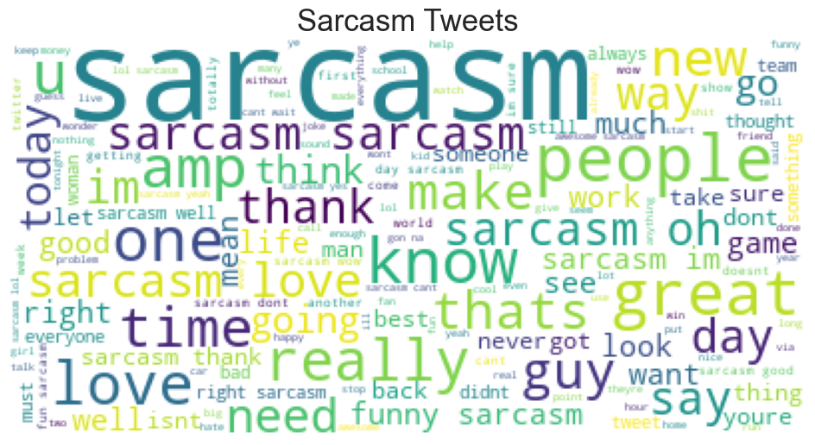
Final Cleaned Dataset

Slide 12
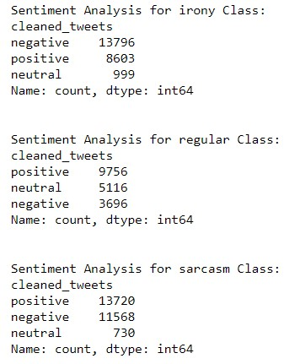
Observations of Unique words :
Top unique words in for tweets :
Sentiment analysis:

Slide 13
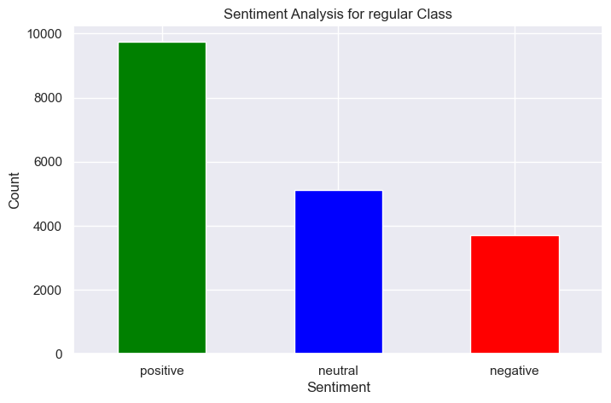
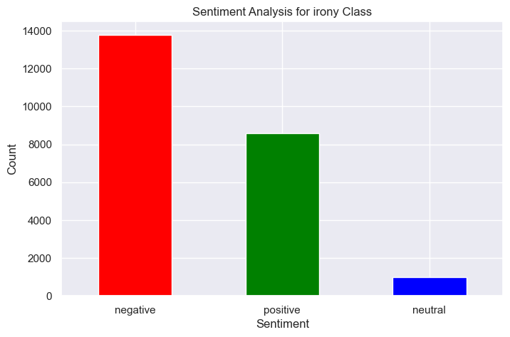
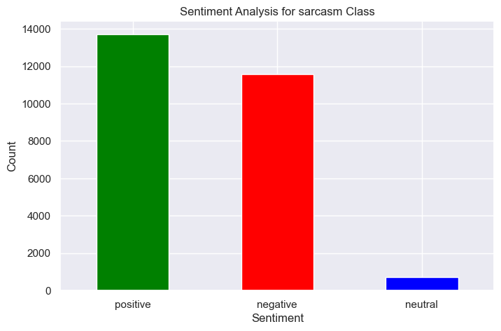
Observations:
This is analyzing the tweets in semantic way i.e. Positive, negative and netural with green, red and blue color bar s respectively.

Slide 14
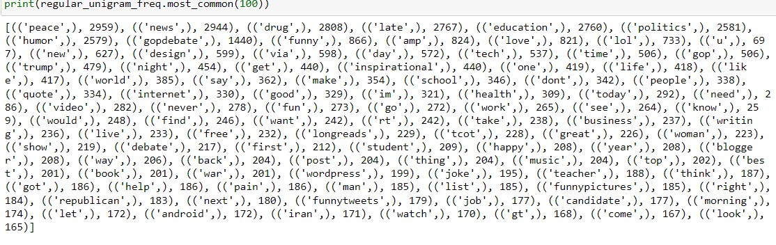
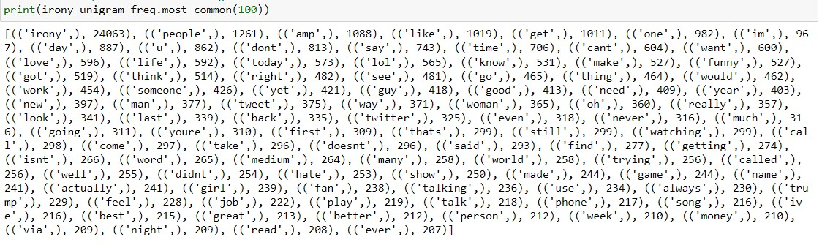
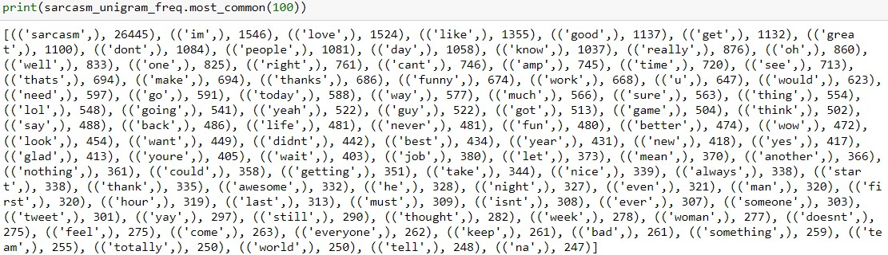
Unigram:

Slide 15
Model Building
NO | MODELS | PRECISION | RECALL | F1-SCORE
1 | Random Forest | 1.00 | 1.00 | 1.00
2 | AdaBoost | 1.00 | 1.00 | 1.00
3 | XGBoost | 1.00 | 1.00 | 1.00
4 | Support Vector Machine | 1.00 | 1.00 | 1.00
5 | Naive Bayes | 0.92 | 0.92 | 0.92
6 | Logistic Regression | 1.00 | 1.00 | 1.00
7 | Decision Tree | 1.00 | 1.00 | 1.00
These are the models build with tfidf vectorization and smote we used for model training and test on our data and their respective precision, recall, f1-score.

Slide 16
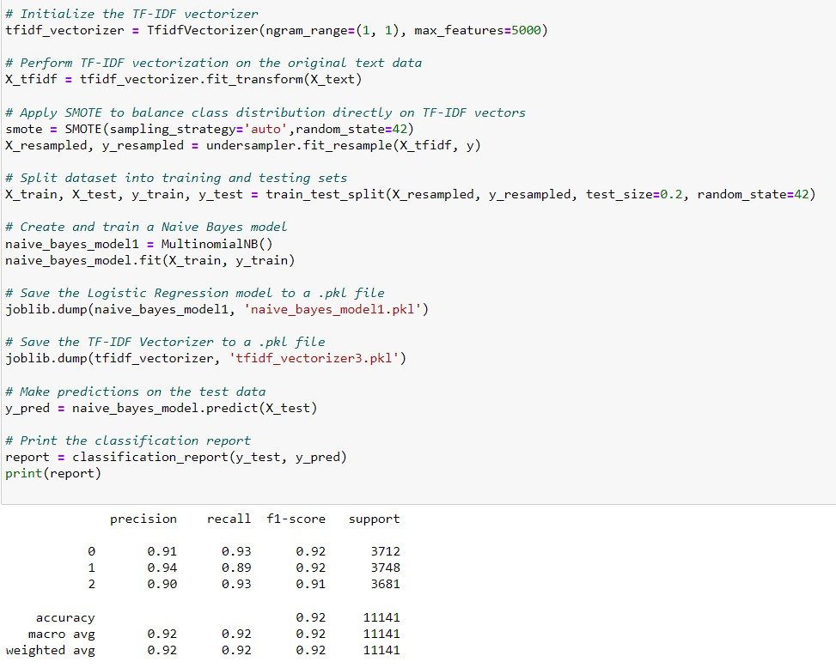
Final Model
Observations:
We build our final model with tfidf vectorization and using smote and naïve bayes classifier because all the model which we tried were getting overfitted for our data.

Slide 17
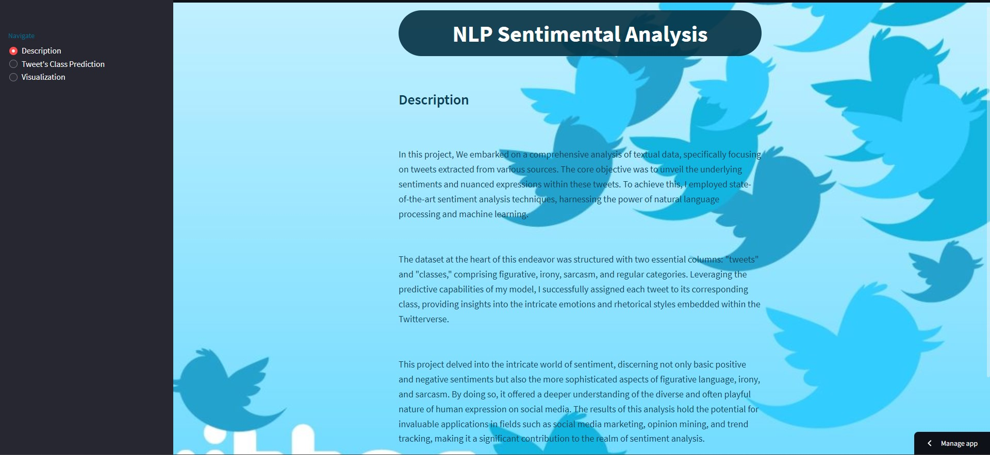
Model Deployment: Using Streamlit

Slide 18
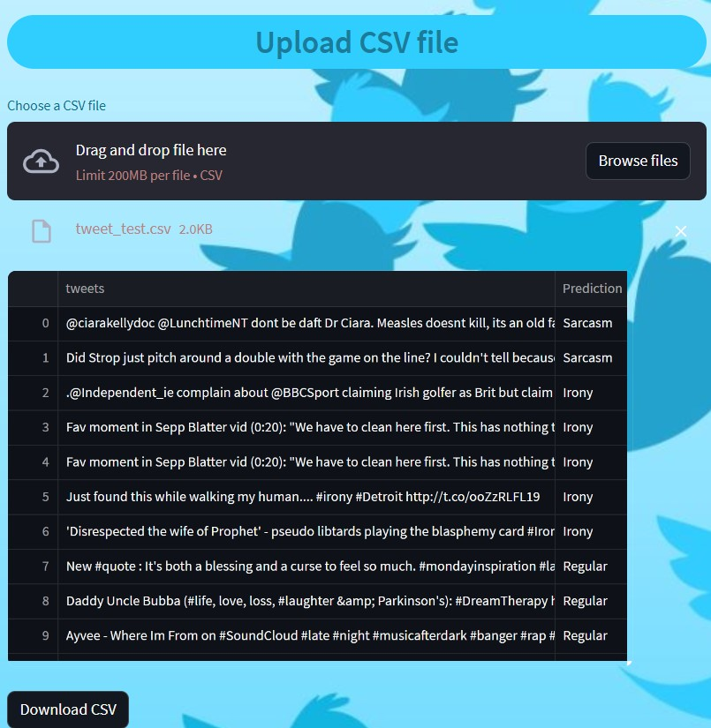
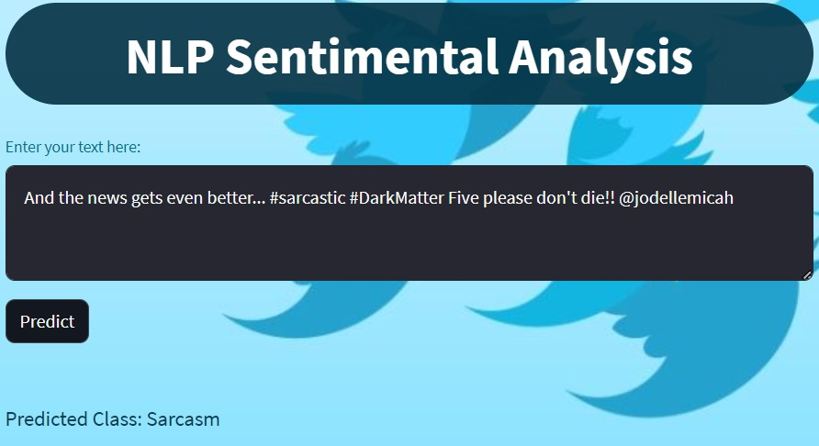

Slide 19
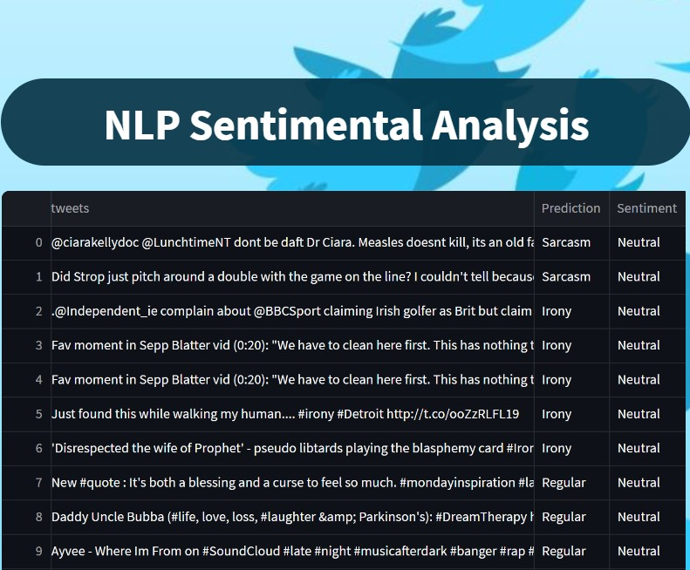
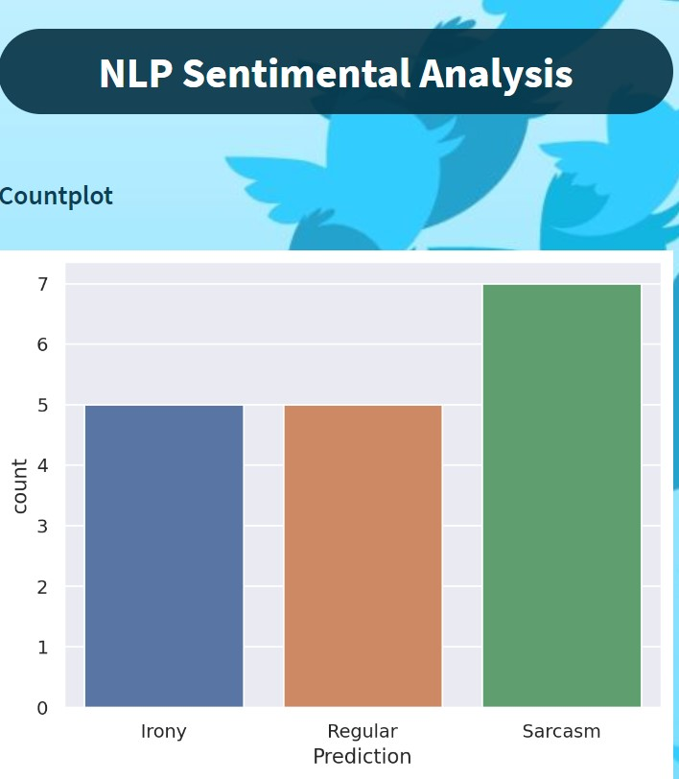
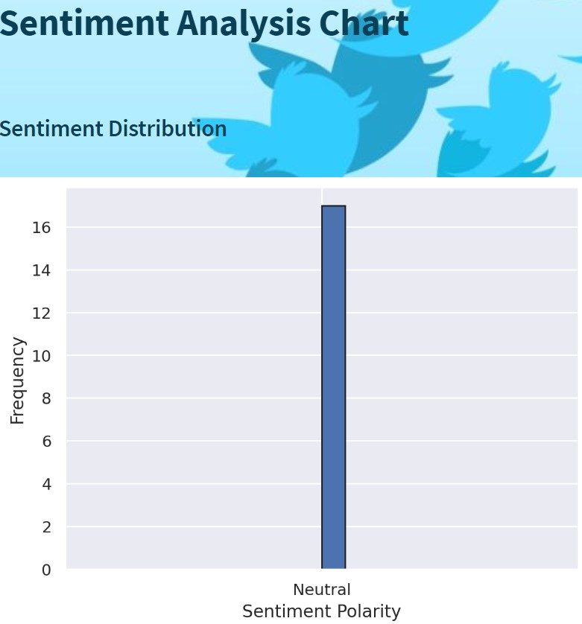
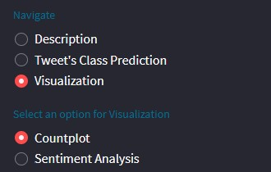

Slide 20
Problems Faced During Project :
Misclassification in figurative class because it contain both irony and sarcasm so no uniqueness in this class.
Choosing the appropriate machine learning model for the task is critical. Different models have different strengths and weaknesses, and selecting the wrong one can result in suboptimal performance.
Overfitting occurs when the model performs well on the training data but poorly on unseen data. This can happen if the model is too complex or if the training data is not representative of the test data.
Deploying a machine learning model to a production environment can be complex. Integration with existing systems, scalability, and maintaining the model's performance in real-time are some of the challenges faced during deployment.
In some cases, the deployment environment may have hardware limitations, such as limited processing power or memory, which can impact the choice of model and its configuration.

Slide 21
Thank You

